Slide 1
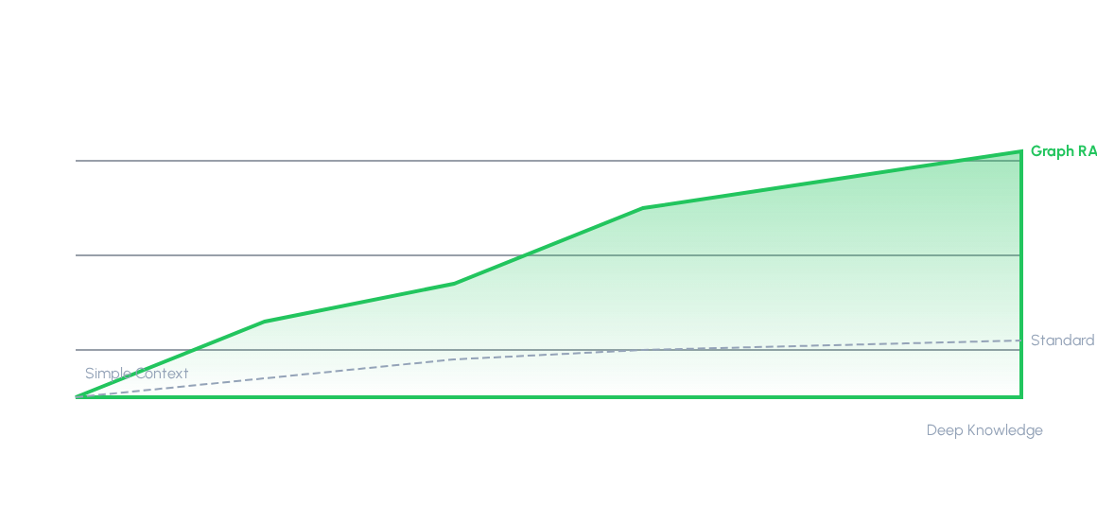
Links: The Engine of RAG
The Semantic Workbench transitions raw information management from traditional, linear chat interfaces into a spatial computing and knowledge synthesis engine. Within this spatial metaphor, Links (Connections) are not merely visual decoration—they represent the cognitive scaffolding of the workspace.
Graph-Guided Retrieval outperforms standard keyword vector search by traversing logical connections.

Slide 2
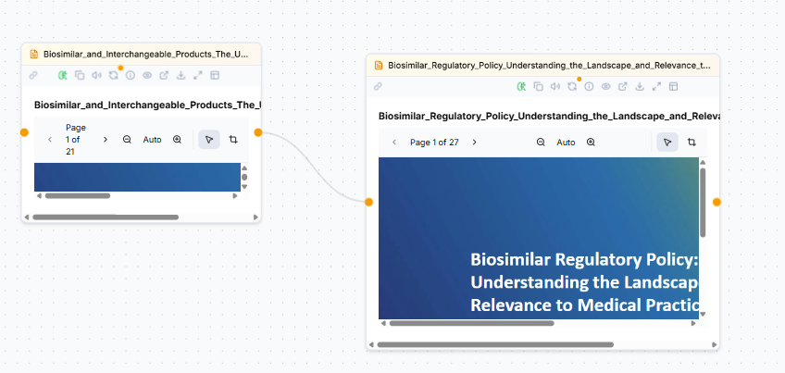
Links
Links establish explicit, machine-readable, and human-interpretable relationships between disparate pieces of information ("Things").
Create a Link
Click a handle and drag to another node to create a link

Slide 3
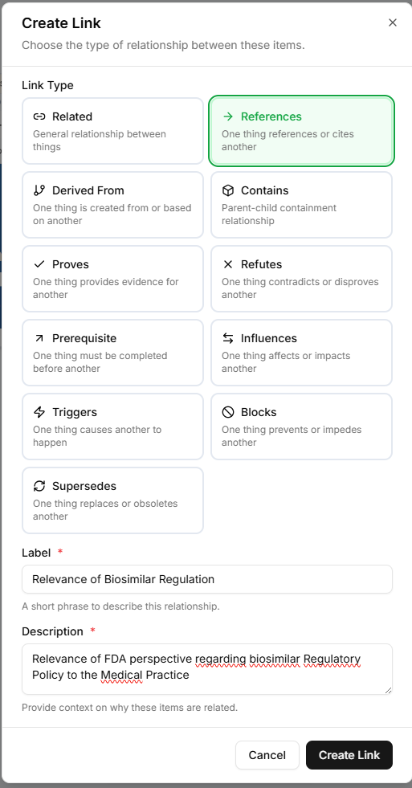
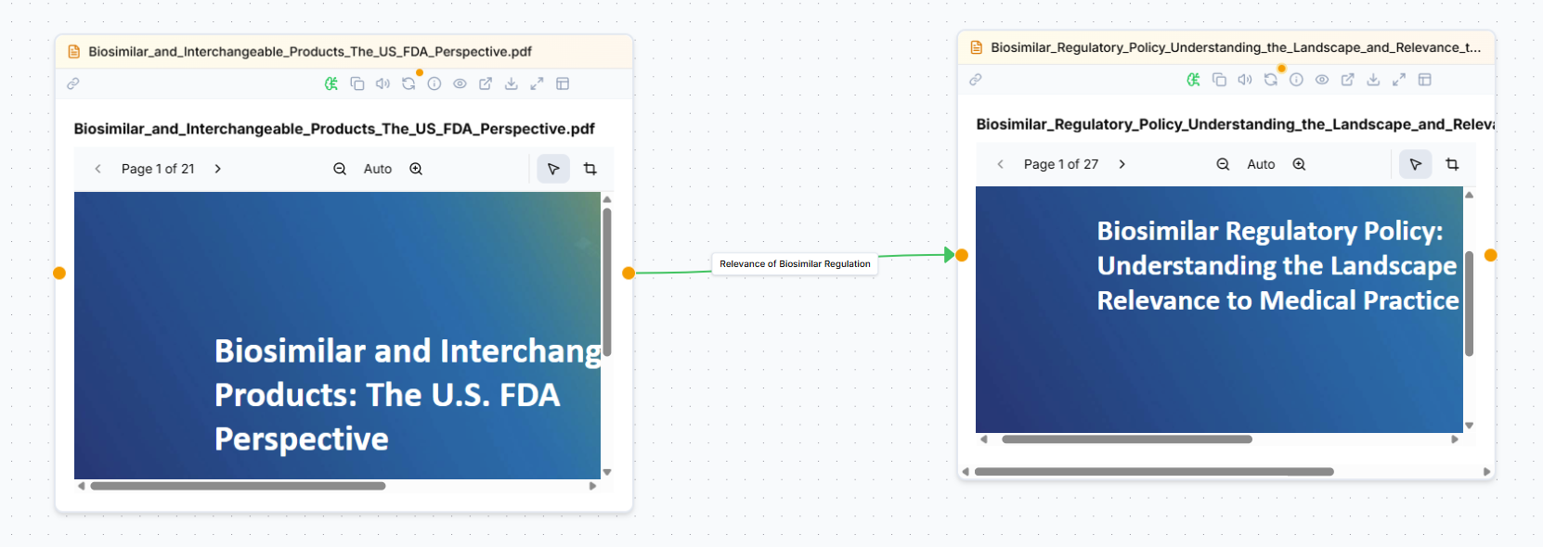
Customizing Link Properties
Links’ properties are used for RAG and document analysis.
Link Configuration
Link Configuration
Relationship Type: Change the predicate (e.g., from 'related' to 'refutes').
Custom Labels: Update the floating text card for immediate clarity.
Description Context: Provide the mandatory "why" behind the connection.
Click on the link’s label to edit properties

Slide 4
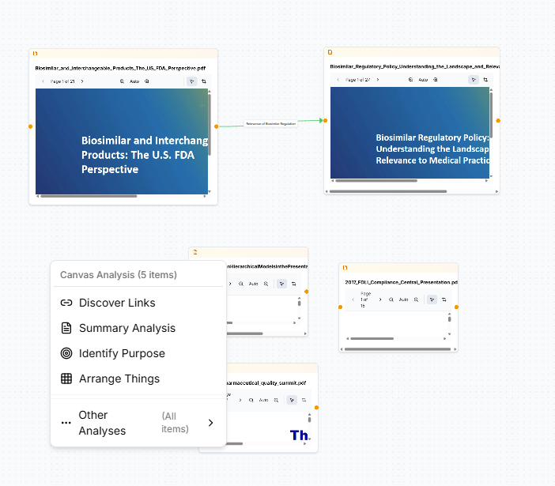
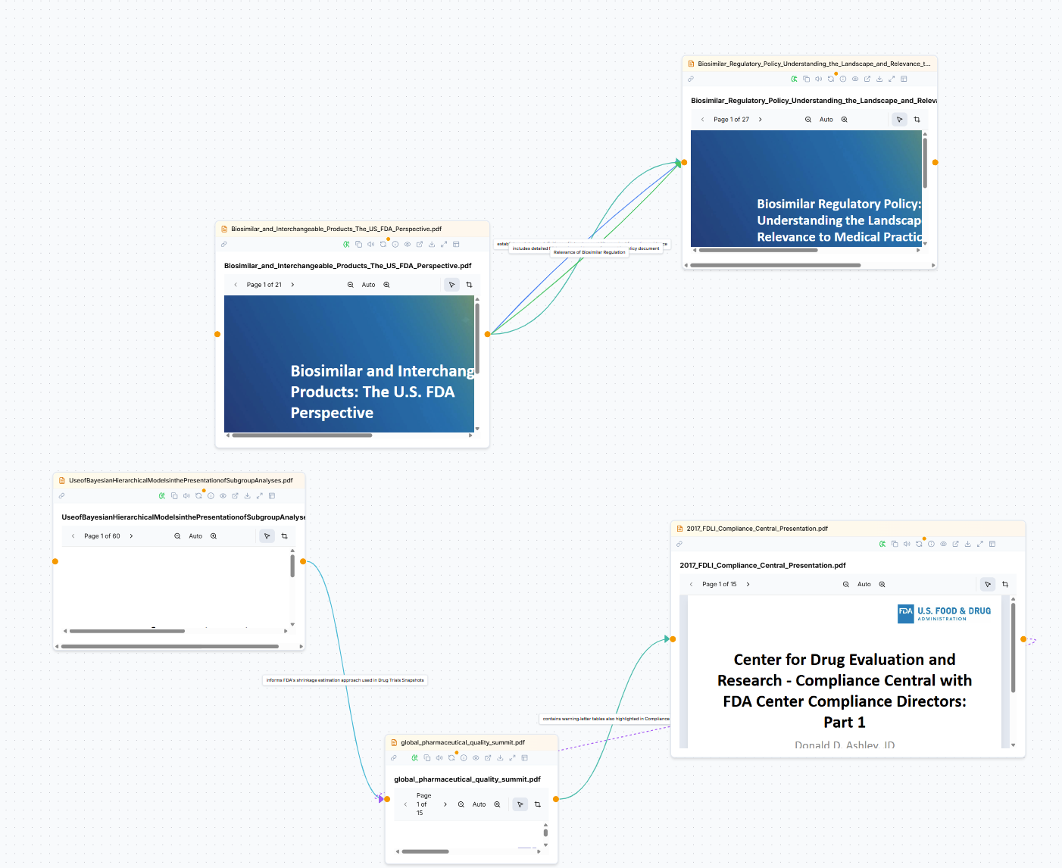
Discovering Implicit Links
Leverage the system's intelligence to find hidden relationships.
Discovery
Discovery Icon: Right-Click on the canvas and select “Discover Links" to activate AI link analysis.
AI Suggestion: Suggested links appear as ghost edges for your confirmation.

Slide 5
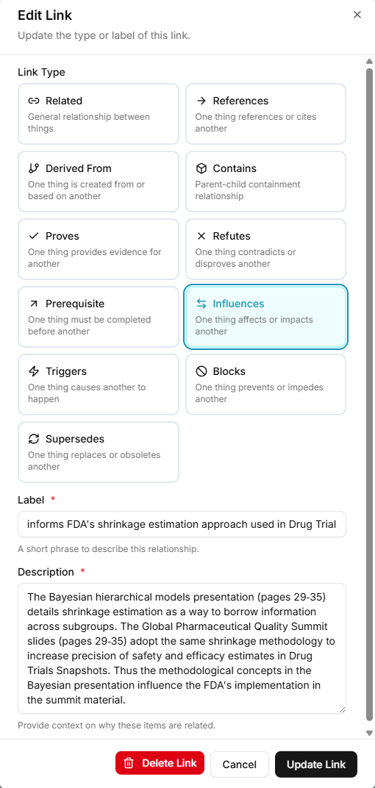
Discovering Implicit Links
Leverage the system's intelligence to find hidden relationships.
Discovery
Labels and Description: Discovered links include detailed label and description for use in RAG
Rainbow Layout
Calculates perpendicular vectors to prevent overlapping lines.

Slide 6
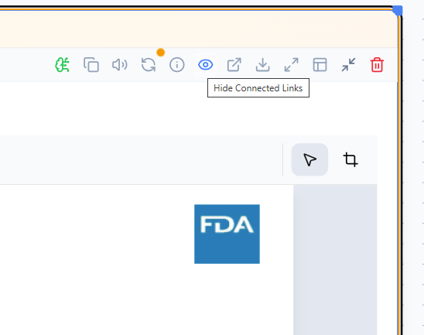
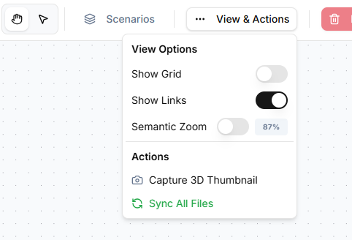
Managing Clutter: Show & Hide Links
Global Toggle
Local Isolation
Hide all links across the entire canvas with a single action to clear visual noise and focus purely on spatial layout.
Select a single "thing" or node and use the “Hide/Show Link” icon to toggle visibility to hide only the links connected specifically to that object.

Slide 7
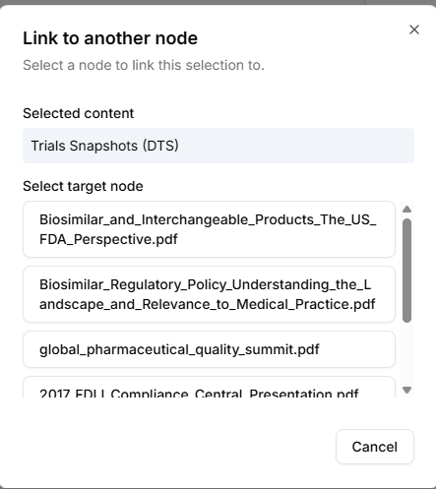
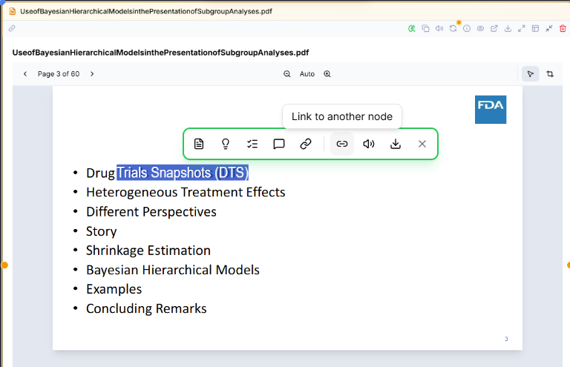
Deep Link Fragments
Link to specific sections inside objects rather than just the whole node
Fragments links
Link to another node: Select a fragment in a document (text or graphic) and use the “Link to another node” contextual icon. Then select the target node.

Slide 8
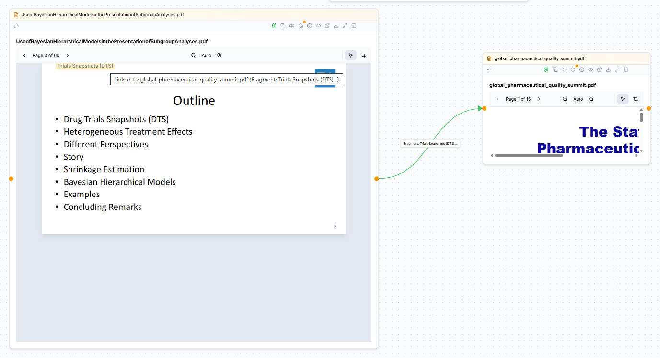
Deep Link Fragment Navigation
Clicking a fragment-based link doesn't just open a document; it takes you exactly where the evidence lies.
Fragments links
Auto-Scroll & Focus: Opens the document in the source node and automatically jumps to the exact page where the fragment is located.
Persistent Highlight: A distinct visual highlight/label marks the precise text or region bounding box.
Interactive Hover Tooltip: Hovering over this highlight reveals contextual metadata, displaying details of the connected target node.

